Slide 1
SEIS752 Spring 2015 Performance Engineering Presentation J. Stark
Agenda
Brief overview – power point
Chalk talk - pain points
Demo a light weight tool

Slide 2
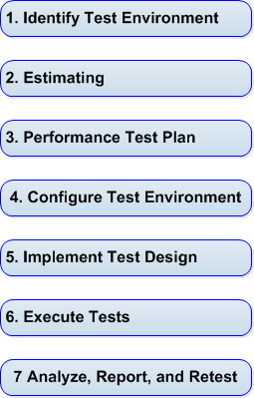
GENERAL PERFORMANCE TESTING CONCEPTS
Core Performance Testing Activities
Reference: Microsoft PerfTestGuide 2007-08-27

Slide 3
GENERAL PERFORMANCE TESTING CONCEPTS
Generating Loads
Tools
SilkPerformer, IBM Rational Performance Tester, HP Load Runner, Selenium, J-Meter
Simulate anticipated user load and mix
Typical load
Endurance testing
Stress testing

Slide 4
GENERAL PERFORMANCE TESTING CONCEPTS
Monitoring
Server performance
Utilization of: CPU, memory, disk I/O, network I/O
Windows – Perfmon counters, Perfstat
Unix – iostat
Linux - Perfstat
Database
Website
All require some instrumentation

Slide 5
GENERAL PERFORMANCE TESTING CONCEPTS
Tuning System
Remove bottlenecks
Application tuning
Improve algorithm
Database optimization
Servers
Network
Improve disk I/O, Memory, Network I/O, thread count,…

Slide 6
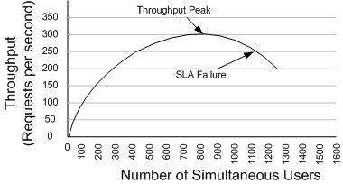
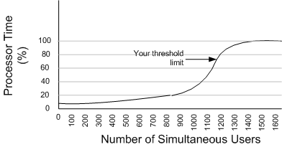
GENERAL PERFORMANCE TESTING CONCEPTS
Finding Capacity Limit

Slide 7
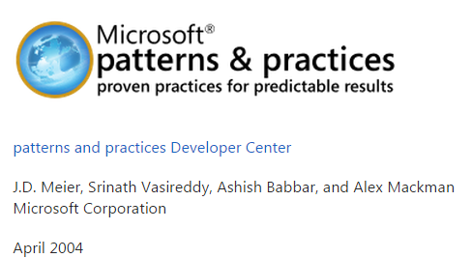
https://msdn.microsoft.com/en-us/library/ff649152.aspx

Slide 8
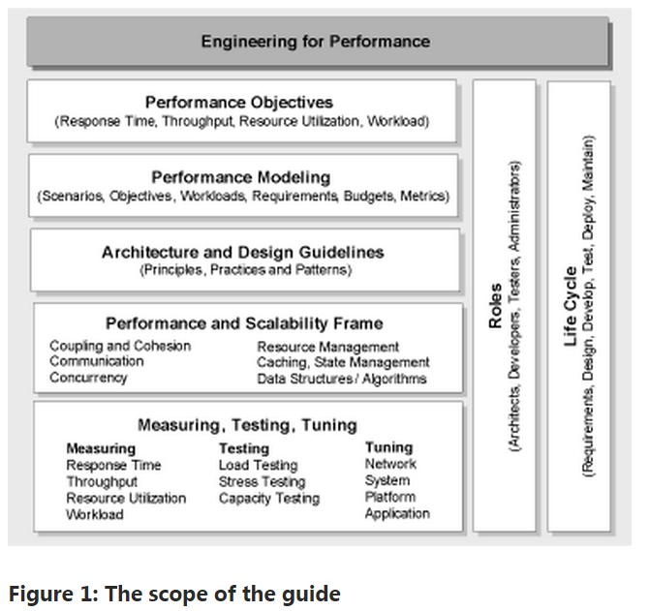
https://msdn.microsoft.com/en-us/library/ff649152.aspx

Slide 9
Some tools for Performance and Scale testing
Debugging / investigative tools
Fiddler
IE Watch
Chrome Inspector
Google POSTman
Industrial strength tools
IBM RATIONAL Performance Tester
HP Load Runner
Selenium
J-meter
Some newer Lightweight tools
Chrome BlaseMeter

Slide 10
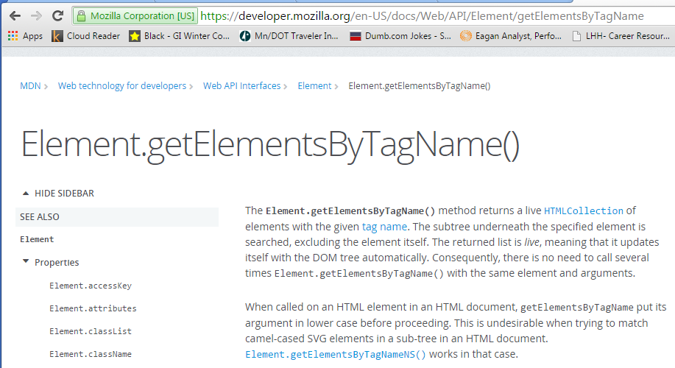
Fiddler

Slide 11
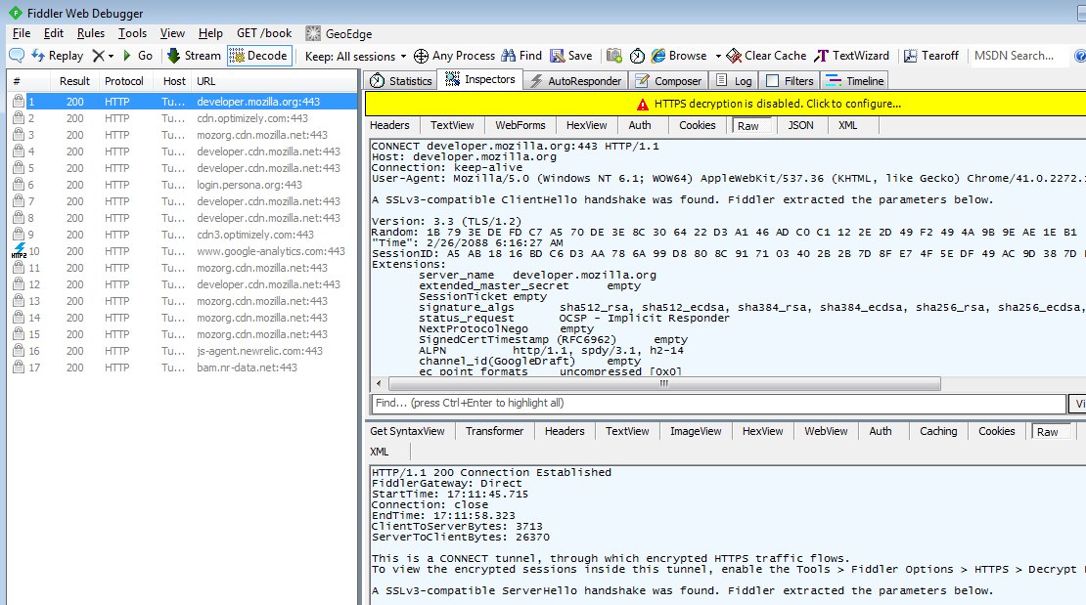
Fiddler

Slide 12
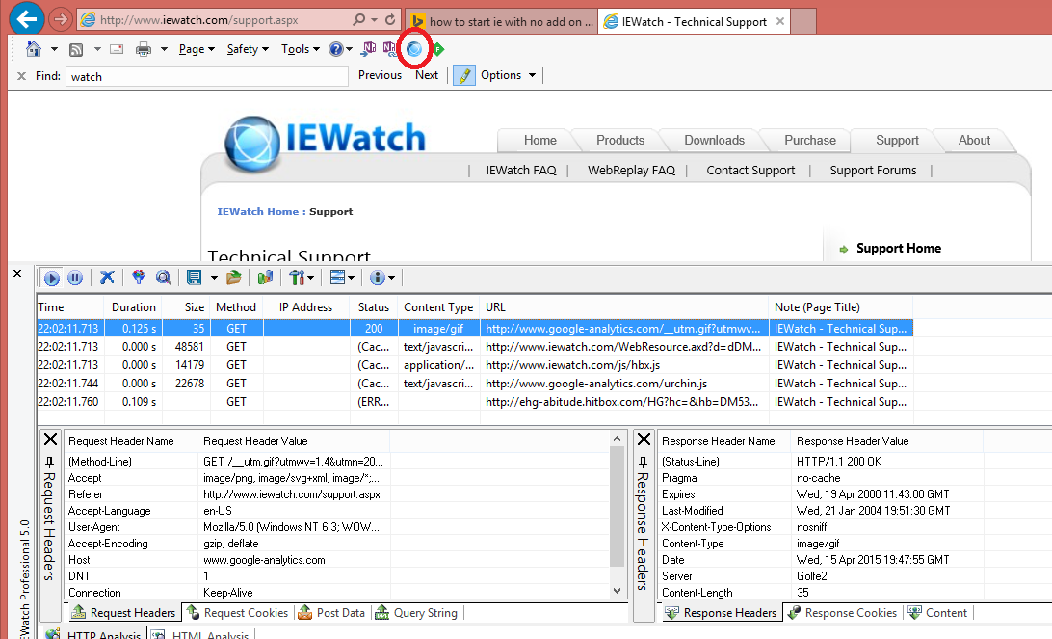
http://www.iewatch.com/

Slide 13
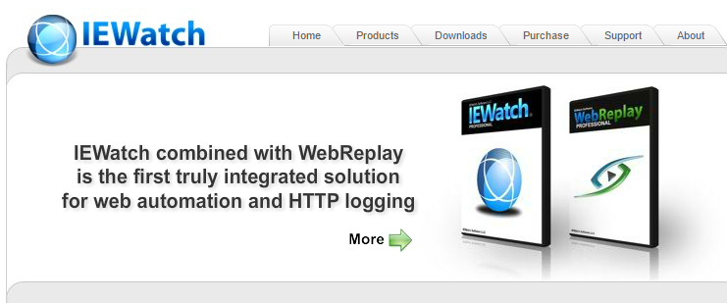
http://www.iewatch.com/

Slide 14
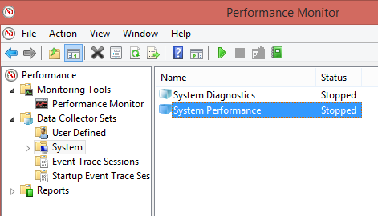
Perf-Stats , PerfMon

Slide 15
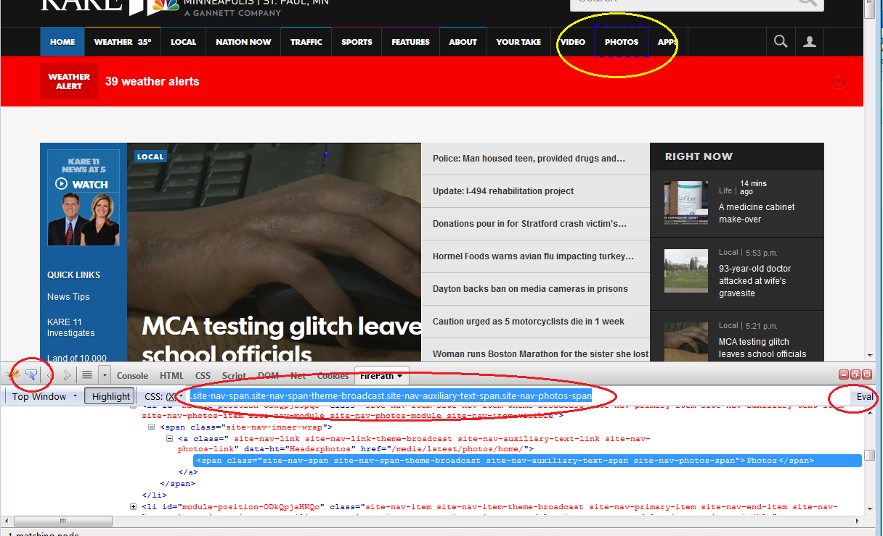
FireFox - Firebug

Slide 16

Seleium
http://www.seleniumhq.org/projects/webdriver/
Selenium...
runs in many browser sand operating systems
can be controlled by many programming languages and testing frameworks.

Slide 17
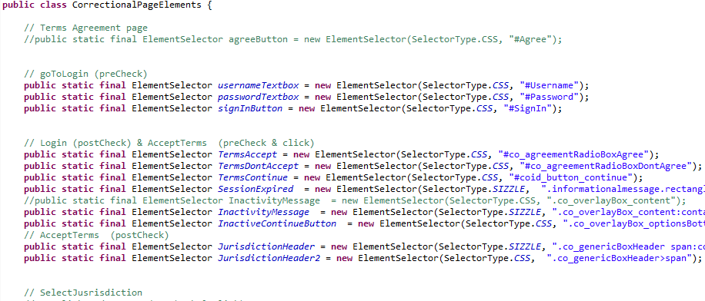
Java Code & Selenium

Slide 18
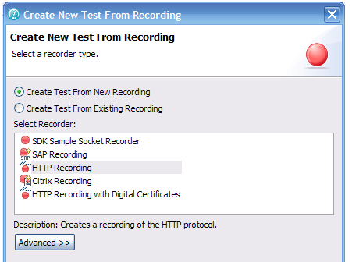
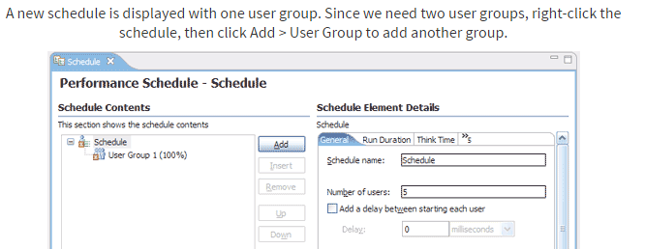
IBM – Rational Performance Tester http://community.topcoder.com/tc?module=Static&d1=tutorials&d2=rationalPerformanceTester

Slide 19
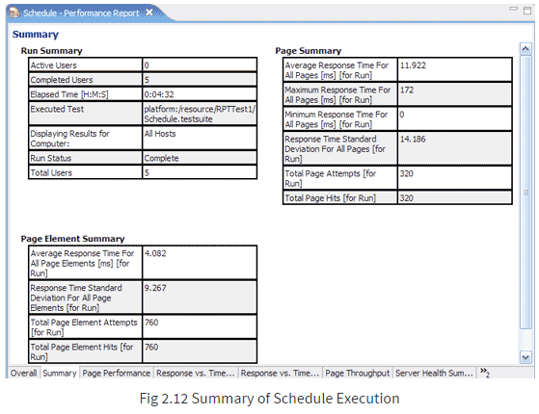
IBM – Rational Performance Tester report

Slide 20
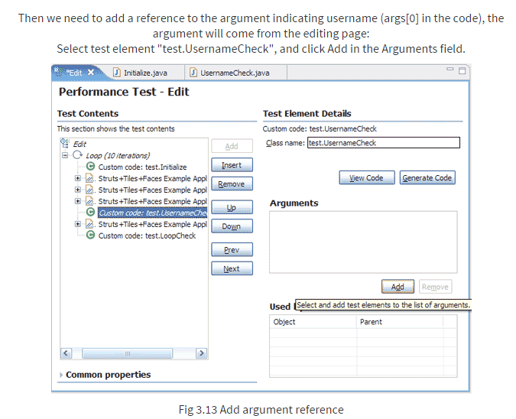
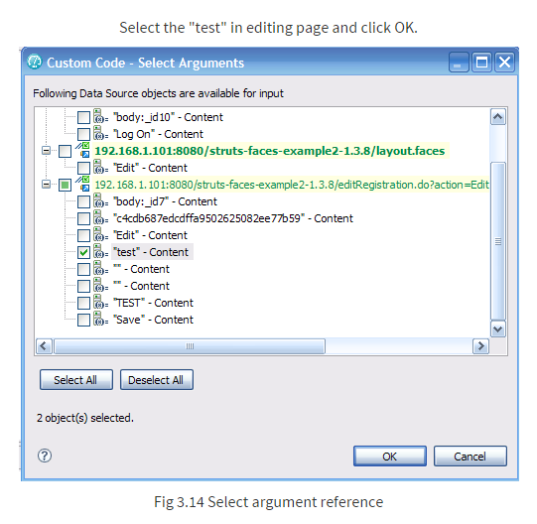
IBM – Rational Performance Tester adding custom code for more functionality

Slide 21
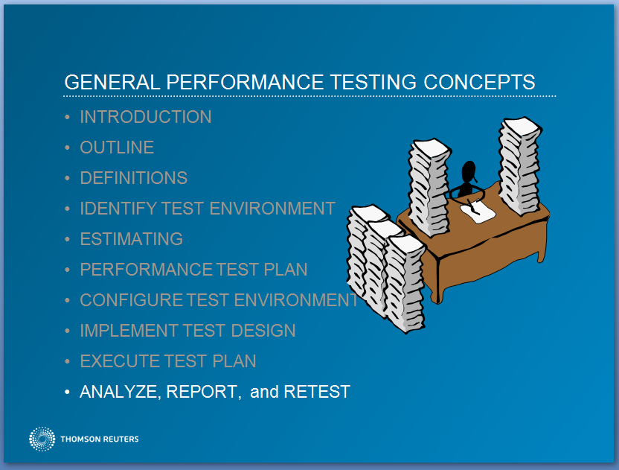
Buried in Data, Consumed by Reporting

Slide 22
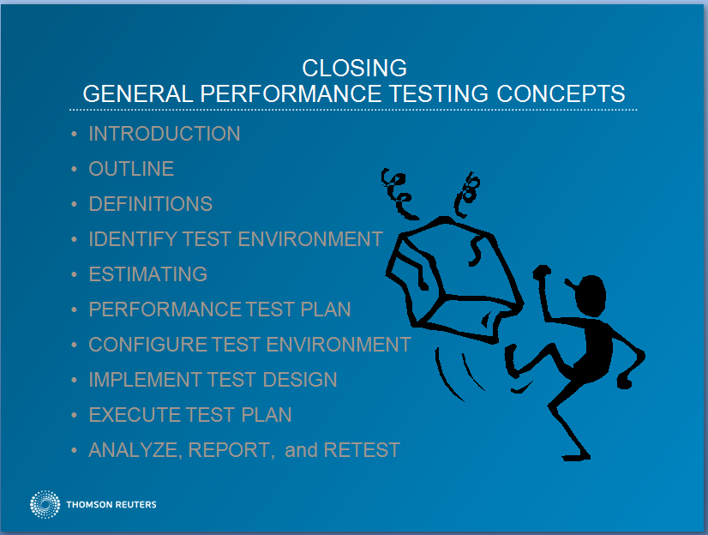

Slide 23
Chalk talk notes
Sketch out a system with multiple layers
Front end with load balancer
Middle tier
Shared services
Multiple databases
Logging timestamps and GUIDs
Accessed from around the world
Hardware tools
Shunra
Foglight
Akamai

Slide 24
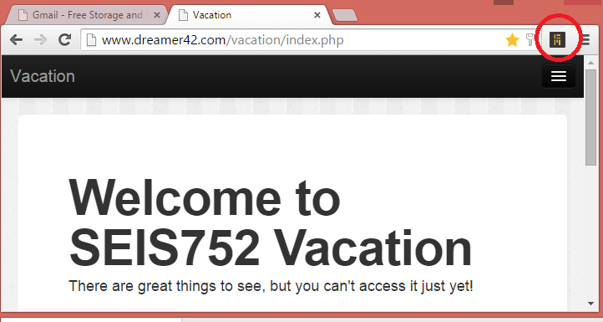
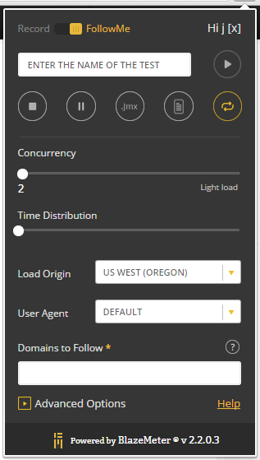
Demo Chrome Blazer
This is only the second time I have tried this. It seems easy to use.

